Slide 1
Introduction to Knowledge bases

Slide 2
The limits of text
Information Retrieval is concerned with the retrieval of documents (webpages) from large corpora. Initially, the retrieval was keyword-based
Good ranking criterion?
Good string similarities?
How can we diversify the results?

Slide 3
The limits of text
Web search has moved from keyword-based to entity-based
Larry Page (2012): “The perfect search engine would really understand everything in the world deeply, give you back kind of exactly what you need” [1]
Machine learning and knowledge representation are now parts of core business in many Web companies [2]
[1] http://fortune.com/2012/12/11/fortune-exclusive-larry-page-on-google/
[2] https://backchannel.com/how-google-is-remaking-itself-as-a-machine-learning-first-company-ada63defcb70#.nljh17nb5

Slide 4
The limits of text
The Latin word data is the plural of datum, “(thing) given”, neuter past participle of dare “to give” (Wikipedia)
Knowledge is a familiarity, awareness or understanding or someone or something, such as facts, information, descriptions or skills (Wikipedia)
Epistemology is the philosophical field that studies theory of knowledge. Plato: Knowledge must be justified, true, believed. Do you agree?
Notes:
Can we believe something that is true?

Slide 5
The limits of text
To overcome the limits of text (data), we must build knowledge repositories from the Web
Manifest knowledge
Meaning accessible to humans. These repositories are called knowledge bases or knowledge graphs
Typically constructed manually or from unstructured sources
Latent knowledge
Meaning is hidden to us. Also called latent models or latent feature models
Typically learned using machine learning techniques
Warning! People have different opinions on the matter!
Extremes are: “Everything can be learned!” and ”Knowledge is only what can be understood!”

Slide 6
Manifest knowledge
Logic is the language that humans designed to express knowledge
Opinion: Knowledge is something we can interpret without ambiguities
Knowledge bases: crystallization of factual knowledge in the form of associations between entities and relations
Can be expressed as first-order logic
Recently Google re-branded knowledge bases as knowledge-graphs
Jacopo
VU_University
worksAt(Jacopo,VU_University)
worksAt

Slide 7
Latent knowledge
Wittgenstein: Meaning is use
Opinion: We do not need to be able to interpret knowledge, as long as it does what it is supposed to do. Do you agree?
Recently, latent models became very popular due to the rise of deep learning
One prominent example is Google’s word2vec [1]
[1] T. Mikolov, I. Sutskever, K. Chen, G. S. Corrado, and J. Dean, “Distributed representations of words and phrases and their compositionality,” in Advances in neural information processing systems, 2013, pp. 3111–3119.

Slide 8
Knowledge bases: Outline
We will discuss the theory behind knowledge bases in more details when we will focus on reasoning (prob. in 4 weeks)
We will discuss latent models in more detail when we will focus on statistical inference (prob. in 3 weeks)
In the remaining of the lecture, I will introduce the largest knowledge bases available on the Web
Next week we will talk about how to construct and how we can use them in combination with text

Slide 9

Knowledge bases on the Web

Slide 10
WordNet
Wordnet is the most famous lexical database for English [1]. Project started in 1985 at Princeton by George Armitage Miller
Groups words into sets of synonyms called synsets
[1] G. A. Miller, “WordNet: a lexical database for English,” Communications of the ACM, vol. 38, no. 11, pp. 39–41, 1995.

Slide 11
WordNet
Words can be monosemous (one meaning) or polysemous (multiple meanings)
Each synset has a gloss (short description) and is connected to other synsets with different linguistic relations. Most important ones are
Hypernyms/Hyponyms (isA)
Meronym/Holonyms (partOf)
DEMO

Slide 12
RDF
The World Wide Web Consortium (W3C) has standardized a number of languages to exchange knowledge on the Web [1]
The Resource Description Framework (RDF) is a standard used to report statements that describe properties of resources
Properties are represented by IRIs while resources are either special IRIs, labels or special placeholders called blank nodes
The statements can be represented as triples of the form <s p o> (subject predicate object) and serialized with different formats: RDF/XML, N3, Turtle
A RDF dataset can be represented as a directed graph
[1] https://www.w3.org/2001/sw/wiki/RDF

Slide 13
RDF
Example
IRIs: http://www.vu.nl, http://www.vu.nl#studies
Literal: “VU University”
blank node: _:x
RDF dataset (serialized with Turtle)
<http://www.vu.nl> <rdf:type> <wikipedia/University> .
<http://www.vu.nl> <rdf:label> ”VU University” .
_:x <http://www.vu.nl#studies> http://www.vu.nl .

Slide 14
SPARQL
RDF datasets can be stored on a variety of engines
Native RDF stores (Virtuoso, Sesame, Jena, etc.)
Relational databases (IBM DB2, Oracle, etc.)
How do we query a RDF dataset?
The W3C has standardized a specific language called SPARQL [1]
SPARQL is a query language which has a SQL-inspired syntax. Finding answers to a SPARQL query corresponds to find all possible graph homomorphisms between the query and the graph
[1] https://www.w3.org/TR/sparql11-query/

Slide 15
SPARQL
Example SPARQL query Answers SPARQL query
Example Input
SELECT ?X,?Y FROM { ?X <rdf:type> <wikipedia/University> .
?X <rdf:label> ?Y . }
{?X-> <http://www.vu.nl>
?Y-> “VU University” }
<http://www.vu.nl> <rdf:type> <wikipedia/University> .
<http://www.vu.nl> <rdf:label> ”VU University” .
_:x <http://www.vu.nl#studies> <http://www.vu.nl> .

Slide 16
DBPedia
Project to convert Wikipedia pages into RDF
Leverages structured content contained in the pages
Infoboxes
Labels
Categories
Redirects
etc.

Slide 17
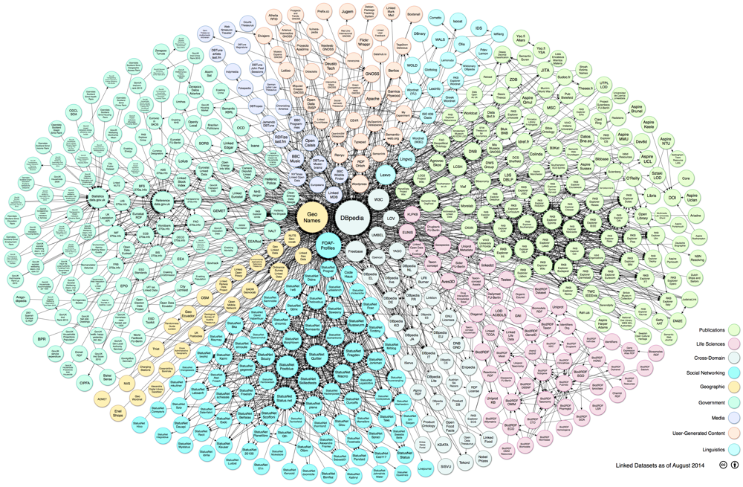
DBPedia
Started in 2007, 4.5M entities, 3B RDF triples [1]
Contains links to other KBs
Widely popular in the “linked-data-cloud”
[1] C. Bizer et al., “DBpedia-A crystallization point for the Web of Data,” Web Semantics: science, services and agents on the world wide web, vol. 7, no. 3, pp. 154–165, 2009.

Slide 18
DBPedia
Fairly large ontology but not rich in terms of expressiveness [1]
320 classes
1650 properties
Alignment between infoboxes and ontologies is done via community-provided mappings
DEMO
[1] J. Lehmann et al., “DBpedia–a large-scale, multilingual knowledge base extracted from Wikipedia,” Semantic Web, vol. 6, no. 2, pp. 167–195, 2015.

Slide 19
YAGO
YAGO (Yet another great ontology) is a project started at Max-Planck Institute for Informatics (2006) [1]
Goals
Unify Wikipedia and Wordnet
Exploit Wikipedia Infoboxes to extract clean facts
Check the plausibility of facts via type checking
Last version is YAGO3
16M+ entities
1.2B+ RDF facts
High standards in terms of quality [2]
[1] T. Rebele, F. Suchanek, J. Hoffart, J. Biega, E. Kuzey, and G. Weikum, “YAGO: A Multilingual Knowledge Base from Wikipedia, Wordnet, and Geonames,” in The Semantic Web – ISWC 2016, 2016, pp. 177–185.
[2] http://www.mpi-inf.mpg.de/departments/databases-and-information-systems/research/yago-naga/yago/statistics/

Slide 20
YAGO
DEMO

Slide 21
Freebase
Freebase was a collaborative Knowledge Base created by its community members
Initially created by a company called Metaweb, it was later acquired by Google in 2010
In 2014 Google decided to shutdown Freebase. Part of the data was moved to Wikidata
1.9B RDF facts

Slide 22
Freebase
LINK

Slide 23

Wikidata
Wikipedia is mainly text. It’s hard to verify and keep consistency
E.g. Population of Rome is reported both in the Italian and English articles. Numbers are always different
Wikidata is the ”data-version” of Wikipedia [1]
Data is validated by the community
Keeps provenance of the data
Multilingual by design
Supports plurality
[1] D. Vrandečić and M. Krötzsch, “Wikidata: a free collaborative knowledge base,” Communications of the ACM, vol. 57, no. 10, pp. 78–85, 2014.
DEMO

Slide 24
Wikidata
Create by people
Allows to explicitly say that something is “unknown”
Use qualifiers to express information that requires arity > 3 [1]
Requires the addition of new nodes that represents the statement
IronLady castMember Meryl_Streep
role (qualifier) Margaret Tatcher
[1] F. Erxleben, M. Günther, M. Krötzsch, J. Mendez, and D. Vrandečić, “Introducing Wikidata to the linked data web,” in International Semantic Web Conference, 2014, pp. 50–65.

Slide 25
Wikidata
1B+ triples
54K registered contributors
15M+ statements
DEMO

Slide 26
BabelNet
It proposes an “encyclopedic dictionary” by merging WordNet and Wikipedia [1]
It has its roots in the linguistic community
It can only be accessed through APIs (but it is free for research)
Three tasks
Combine Wordnet and Wikipedia by establishing mapping between them
Harvest multilingual lexicalizations (using Wikipedia inter-language links and machine translation)
Establish relations between Wordnet synsets
[1] R. Navigli and S. P. Ponzetto, “BabelNet: The automatic construction, evaluation and application of a wide-coverage multilingual semantic network,” Artificial Intelligence, vol. 193, pp. 217–250, 2012.

Slide 27
BabelNet
See http://babelnet.org/ for details DEMO

